Slide 1
Lab 2: Sanger Sequencing and Sequence Editing
BIOL 4174/5174: Conservation Genetics Lab
1/31/2018

Slide 2
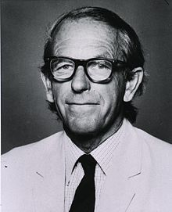
Sanger Sequencing
Also known as “chain-termination” sequencing
Named for lead developer Frederick Sanger
Published in 1977
It earned him his 2nd Nobel Prize in Chemistry
Used in 1990s to sequence the human genome
Still widely used for:
Targeted sequencing of single genes
Smaller scale projects
Generating high accuracy, long (>500bp) continuous DNA reads, although PacBio and Oxford Nanopore are taking over this niche

Slide 3
Sanger Sequencing
General process:
Amplify a gene or region of interest
Polymerase chain reaction (PCR)
Create randomly terminated fragments of the amplicon
Uses modified nucleotides called ddNTPs
Separate those fragments by length (gel electrophoresis)
Some method of detection to read the last base of each fragment
Modern technologies accomplish this using a laser and fluorescent dye-labelling

Slide 4
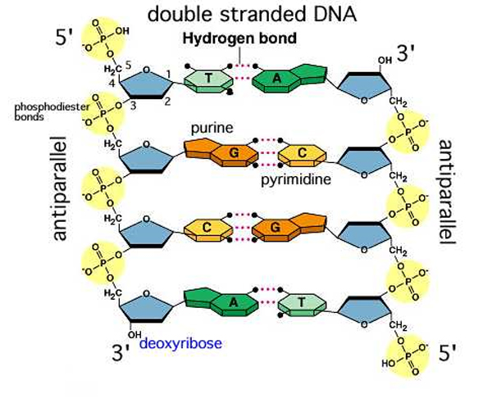
DNA – Two antiparallel strands

Slide 5
DNA – Addition of nucleotides
Deoxynucleoside triphosphates (= dNTPs) are the “building blocks”

Slide 6
DNA – Addition of nucleotides
Polymerase forms bond between 3’ hydroxyl and 1st phosphate of incoming dNTP

Slide 7
DNA – Addition of nucleotides
New base added to growing chain

Slide 8
Fundamental principle of Sanger Sequencing
Dideoxynucleoside triphosphates (ddNTPs) lacking 3’ hydroxyl group

Slide 9
Fundamental principle of Sanger Sequencing
STOPs addition of new nucleotides because new phosphodiester bond can’t form without 3’ hydroxyl group!

Slide 10
dNTP vs ddNTP

Slide 11
Step 1: Polymerase Chain Reaction (PCR)
Method used to amplify genes or regions of interest
Can efficiently amplify region up to 3kb
More realistically ~1kb reliably
Neat animation: https://www.youtube.com/watch?v=2KoLnIwoZKU
More detail of reaction components: https://www.youtube.com/watch?v=DkT6XHWne6E

Slide 12
Step 2: Random chain termination
Similar to PCR, but with mix of dNTPs and ddNTPs
One reaction uses ONLY a forward or reverse primer
These forward and reverse strands are usually both sequenced separately
Modern methods ddNTPs labelled with fluorescent dyes
E.g. ”BigDye terminator kit” by Thermo-Fisher

Slide 13
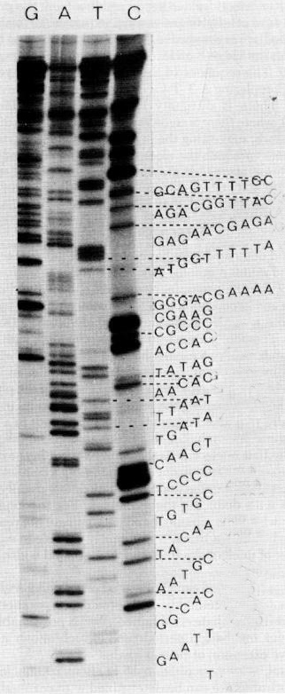
Step 3+4: Sequencing – The Early Days
Four separate reaction vials: One each for ddATP, ddGTP, ddTTP, ddCTP
Each reaction loaded into a separate well on a large slab gel
Electric current separates fragments
Smaller fragments run more quickly through gel
Gel is “read”to reconstruct sequence
https://www.youtube.com/watch?v=FvHRio1yyhQ

Slide 14
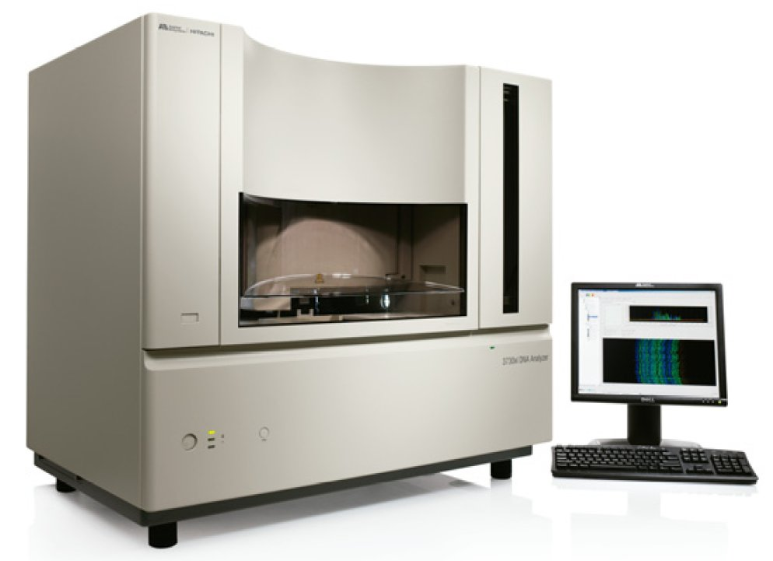
Step 3+4: Sequencing – Current Methods
Single reaction vial: ddATP, ddGTP, ddTTP, ddCTP each labelled with different fluorescent dye
Electrophoresis in single small capillary, in an automated sequencer
Faster results, higher resolution
https://www.youtube.com/watch?v=e2G5zx-OJIw

Slide 15
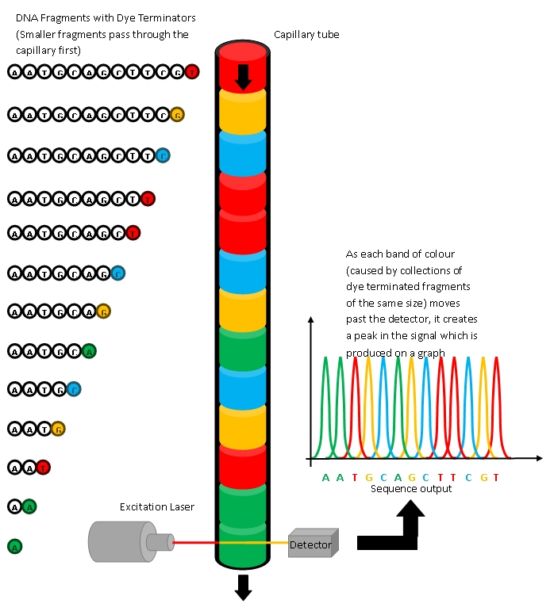

Slide 16
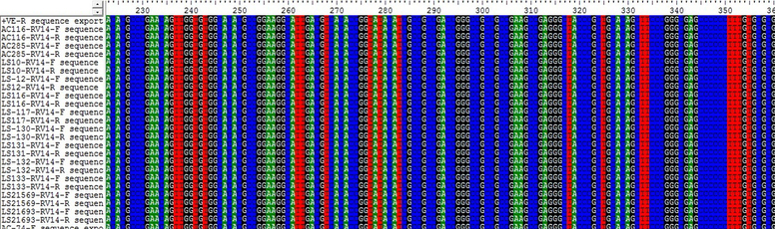
Sequence Editing
Can be difficult and time consuming
One of the most critical steps of a genetic study
Sequence editing programs make errors that you must manually fix
Can be subjective, human error
Garbage in = garbage out
Ultimately, sequenced should be aligned so that homologous sites line up with one another

Slide 17
Sequence Editing - Program Options
Not Free
Free
Sequencher
Probably the best option
Sequence editing only
Price: ~ $1800
Geneious
More than sequence editing
Tries to do everything
Price:
Academic: $795
Student: $395
Chromaseq (Mesquite package)
Probably the best free option
Pros:
Windows, Mac, or Linux
Frequently updated
Cons:
Requires Java
Depends on additional free programs
Kind of annoying to set up
BioEdit
Windows only
Cannot make contigs
No longer being regularly updated

Slide 18
Mutation
Understanding mutation is required for sequence editing
Computer software doesn’t understand mutation
Knowing sources and relative rates of different types of mutations helps you to manually correct errors in your sequences
Protein-coding DNA usually follows certain patterns
Why? → Evolutionary conservation prevents many changes
Many mutations immediately purged by purifying selection
Non-coding DNA usually subject to fewer “rules”

Slide 19
Mutation Types
Point mutations – single base substitutions (i.e., one base is replaced with another).
Can be silent (mutation does not change resulting amino acid sequence)
Insertion – one or more new bases are inserted into a DNA sequence
Deletion – one or more bases are deleted from a DNA sequence
Frameshift – a change in the reading frame of a protein-coding sequence caused by insertions/deletions (indels) whenever bases are not gained or lost in multiples of 3.

Slide 20
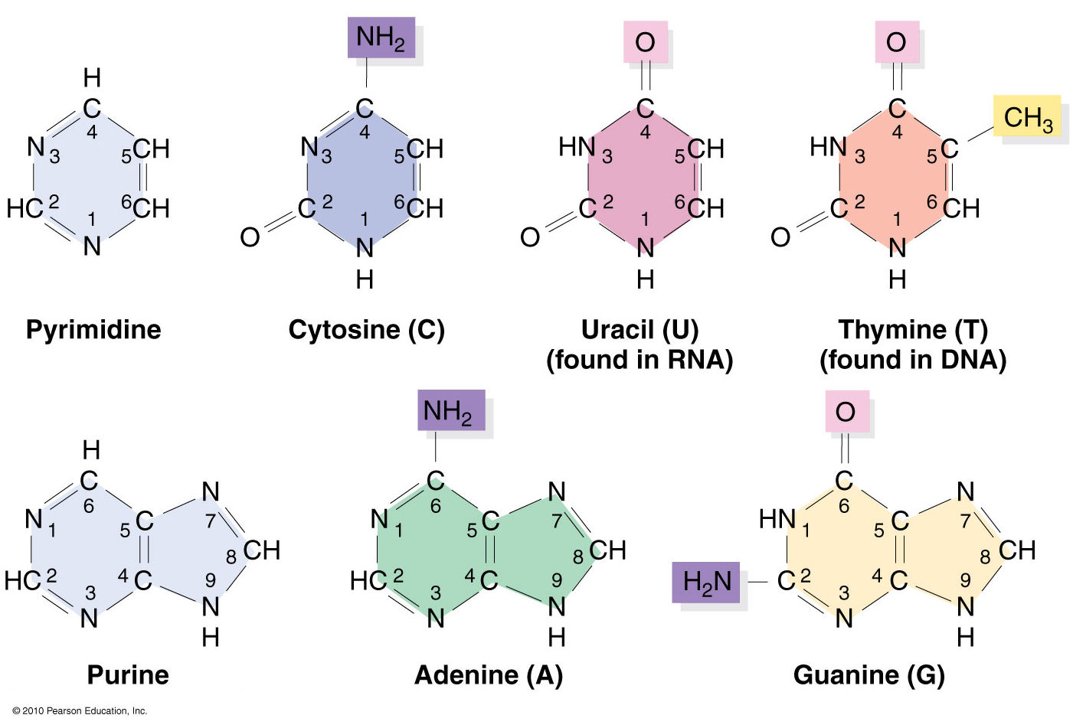
Purines and Pyrimidines

Slide 21
Transitions vs. transversions
A
C
T
G
Substitution (Point mutation) – one base is exchanged for another
Transition (Purine ←→ Purine; Pyrimidine ←→ Pyrimidine)
More common than transversions
Transversion (Purine ←→ Pyrimidine)
Notes:
Transitions more common because: 1) More easily generated due to the shapes of the molecules; 2)More likely to be synonymous

Slide 22
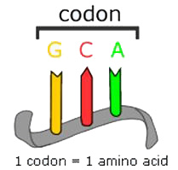
Codon Position
Codon = 3 bases that code for an amino acid
A change in the 1st or 2nd codon position almost always changes the resulting amino acid
A change in the 3rd codon position is least likely to influence the amino acid
2nd codon position
1st codon position
3rd codon position
5’
3’

Slide 23
Genetic Codes
There are several different genetic codes

Slide 24
Example: Mutation from TCA → TCG
TCA translates to serine
TCG also translates to serine
This mutation did not change the amino acid, it is synonymous or silent
3rd codon position changes are more likely to be synonymous

Slide 25
How does this information help in editing?
Protein-coding genes
Indels will be rare, occurring mostly among highly divergent taxa
When present, indels usually occur in multiples of 3
Frameshift mutations exceedingly rare
Substitutions will be most common at the 3rd codon position
Least likely to change amino acid sequence
Non-coding DNA sequences (such as introns or the mitochondrial control region)
Fewer restrictions concerning mutation type, or where mutations can occur.
Higher probability of seeing insertions or deletions

Slide 26
How does this information help in editing?
Amino acid translation
Can be used to check your sequence
Must select correct genetic code
If you see stop codons in the middle of a gene…
The wrong genetic code might be selected
The sequence editing program may have erroneously inserted gaps or additional bases that have shifted the reading frame
Sometimes genes overlap (i.e., the start codon for a gene may be found within the sequence of another) and occur in different reading frames.

Slide 27
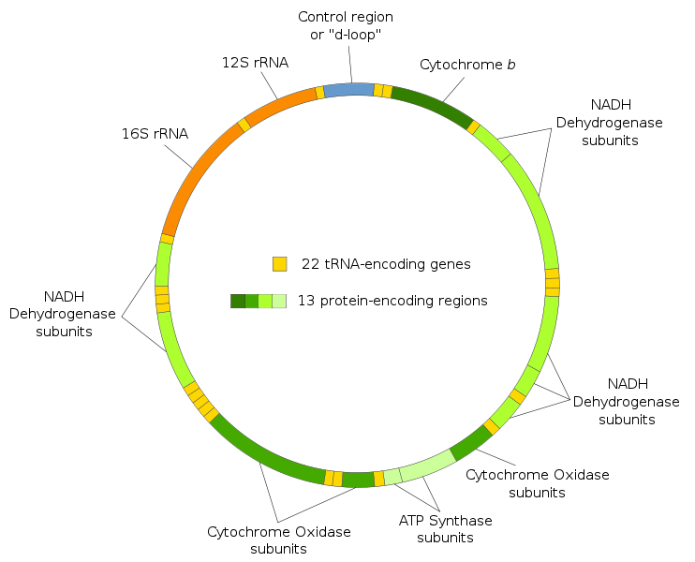
Animal Mitochondrial Genome
mtDNA
15-20kb in animals (Very compact)
37 genes
Gene order mostly conserved
Recombination rare
Usually Haploid
Maternal Inheritance*

Slide 28
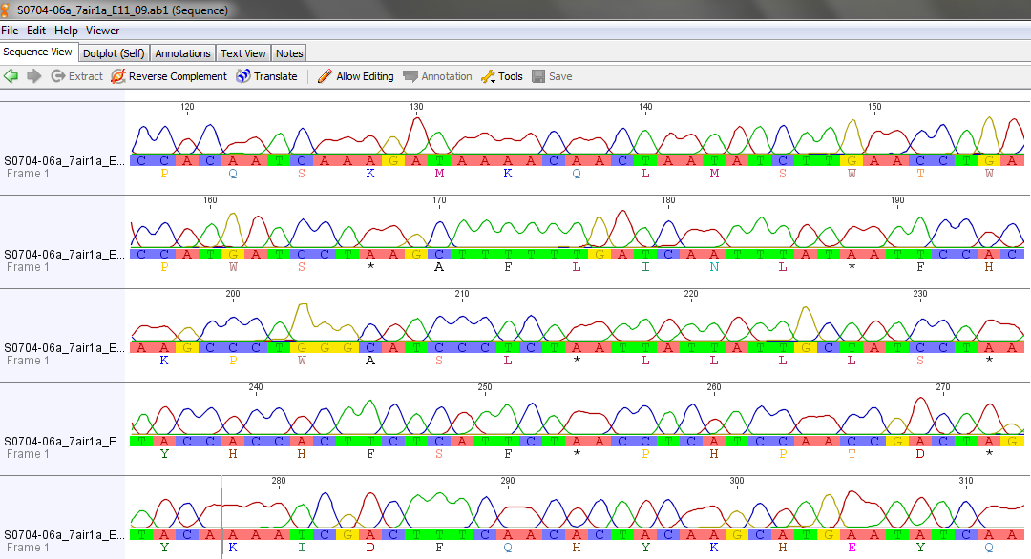
Mitochondrial DNA

Slide 29
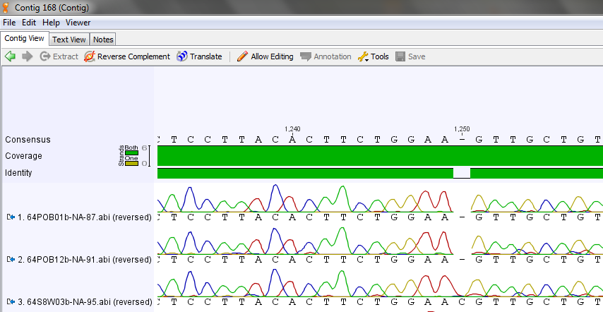
Mutations, sequence editing, and alignment
Sequence editing software will erroneously insert gaps

Slide 30
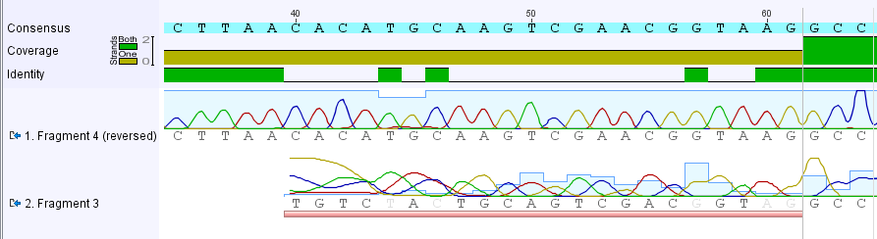
Why do we sequence both forward and reverse?
The ends of a sequence may be difficult to read.
Use the “cleaner” strand in these areas because it is more reliable

Slide 31
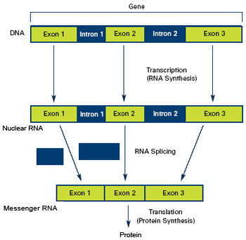
Nuclear DNA
Diploid, biparental inheritance
Introns
Non-coding nucleotide sequences within genes that are removed from mRNA prior to translation.
Useful for:
Phylogenetics
Phylogeography
Hybridization studies

Slide 32
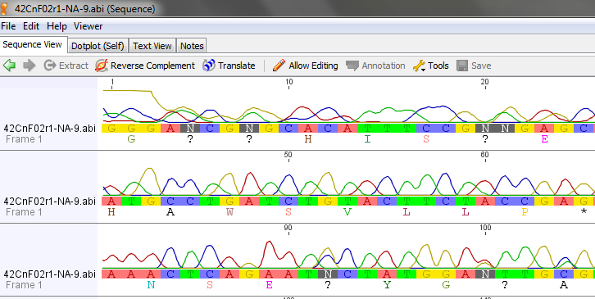
Nuclear DNA
Heterozygotes will be identified by double peaks

